Slide 1
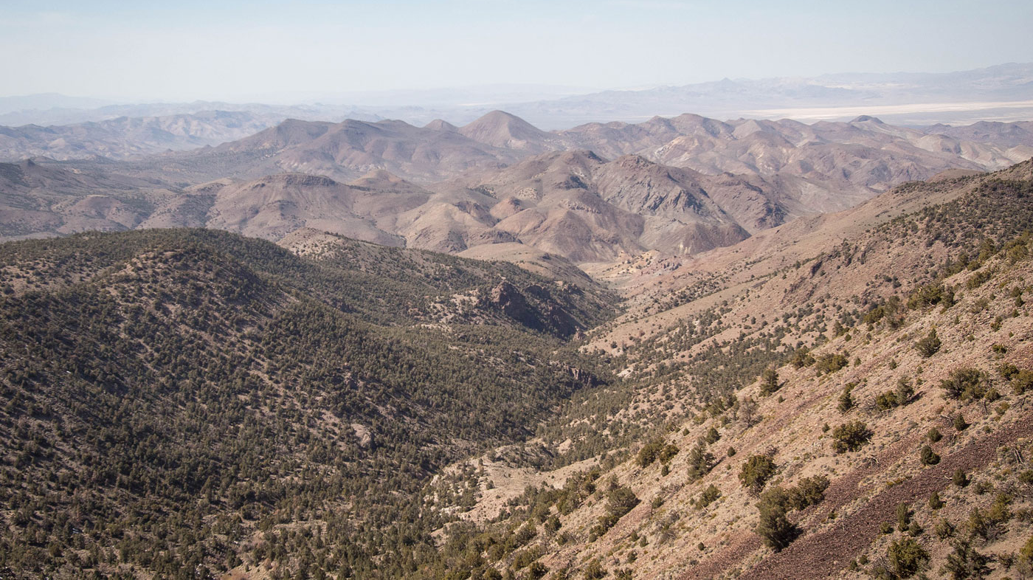
The Gabbs Valley Range- A Well Exposed Segment of the Walker Lane in West-Central Nevada
Paper by Ekren & Byers (1984)
Presentation by Solomon Feinstein

Slide 2
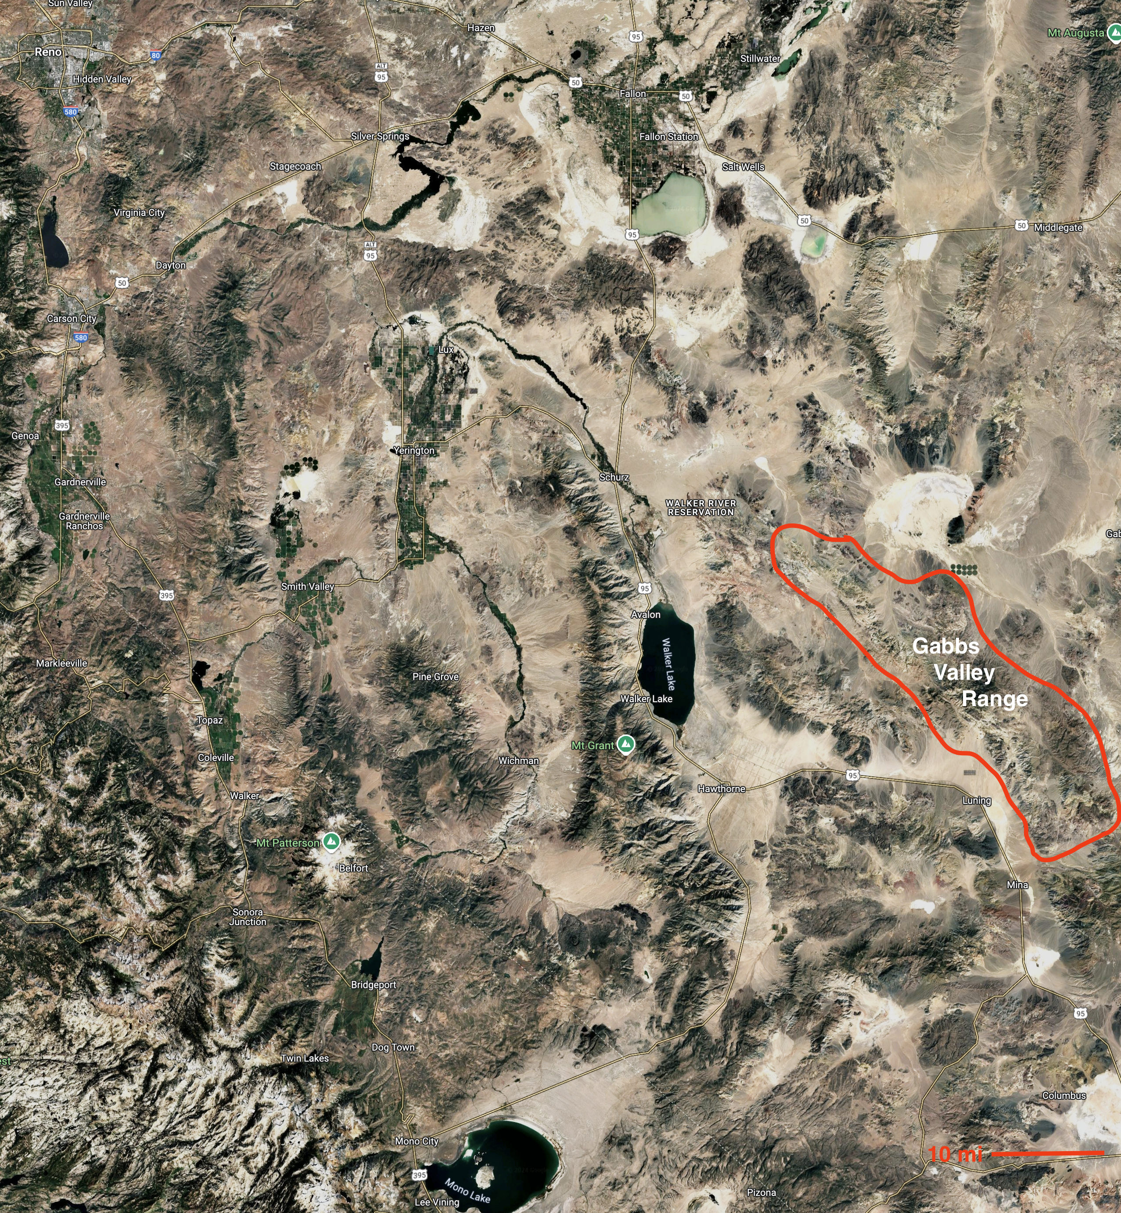
Introduction
Located in Central Walker Lane, The Gabbs Valley Range contains several major faults, including:
4 NW-striking right-lateral strike slip faults showing 48-60 km of offset
A network of NE-trending left-lateral faults (conjugates of the RLF’s)
Abundant NW-striking Listric Normal Faults (parallel to RLF’s, down to the west)
Nearly Flat Detachment Faults synchronous with Listric Faults & RLF’s
Steeply dipped Normal Faults (75-80º), some of which are mineralized

Slide 3
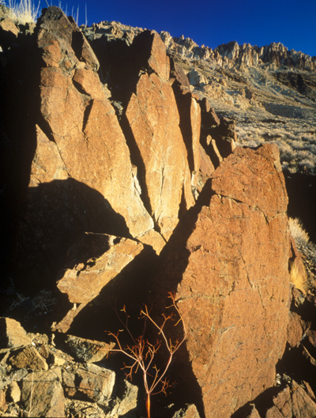
The Rocks…
Oldest rocks in the range are sedimentary rocks from the Triassic & Jurassic (252-145 MA), which were extensively folded and thrusted during the Jurassic
The area was then intruded by a large Mesozoic Batholith, related spatially and temporally to the Sierra Nevada Batholith
Tertiary volcanism then commenced, lasting from 29-6 MA
The excellent exposures of rock in the range reveal faults that are integral to the strike-slip system, including detachment and listric faults

Slide 4
4 Right Lateral Strike Slip Faults
Indian Head Fault | Gumdrop Hills Fault | Benton Spring Fault | Petrified Spring Fault
~4 km of offset Separates Mesozoic Pluton from Quaternary Alluvium Extensive erosion of fault scarp suggests last movement was likely during Pleistocene | ~9 km of offset Most displacement occurred before 5.8 MA latite intrusion Significant because it separates rock unit cut up by listric faults on NE but not SW side of fault | 6.4-16 km of offset Widest breccia/gouge zone in the range (100+ meters) Fault is mineralized in some Tertiary Volcanics within 30 m of fault Springs occur on this fault | >16 km of offset Fault forms scarps and shutter ridges in alluvium, suggesting continued activity today Showed movement in 1932 Cedar Mountain Earthquake (Mw 7.3)

Slide 5
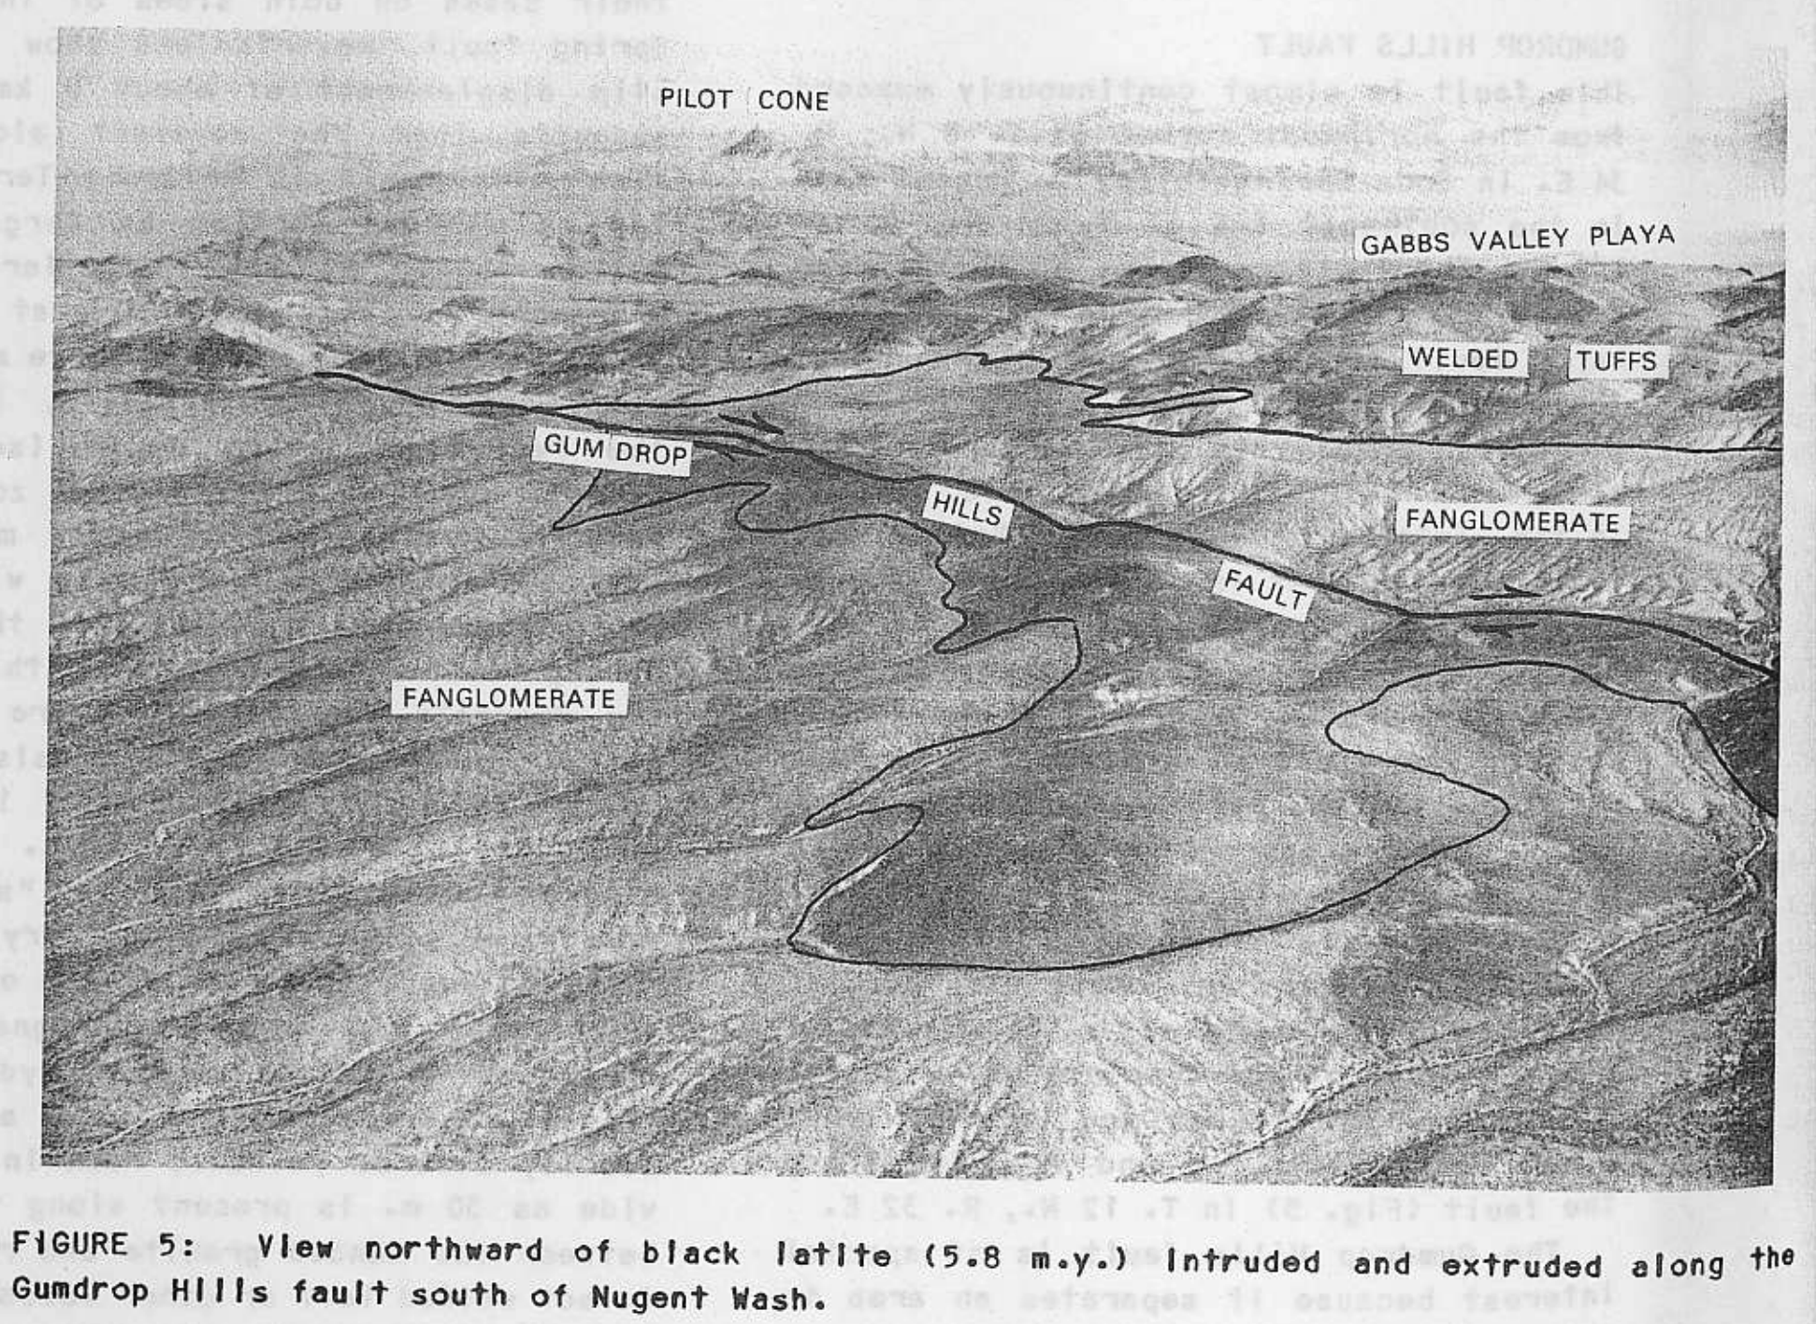
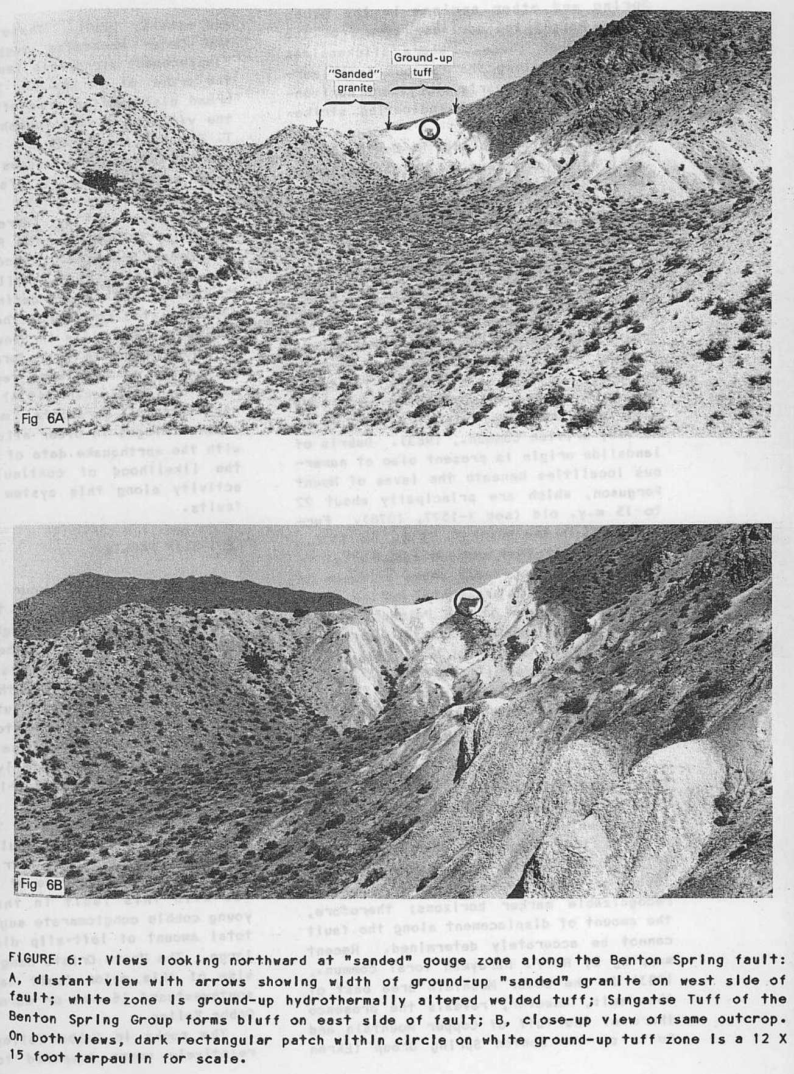
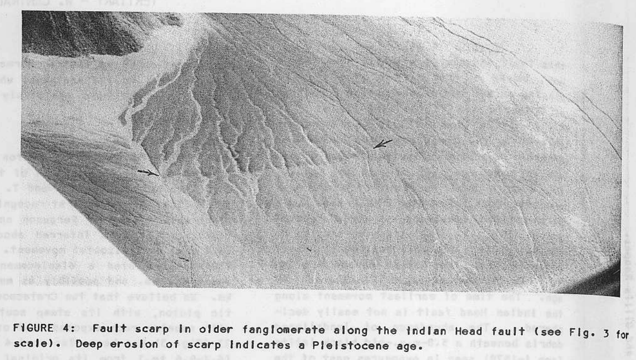

Slide 6
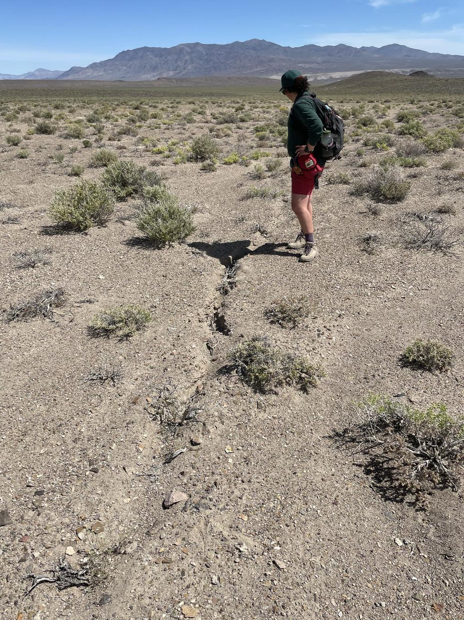
Left-Lateral Strike Slip Faults
Occur sporadically, mainly as subordinate faults between the main RLSSF’s in the range
Most notable LLSSF cuts through Gabbs Valley along the east flank of the Monte Cristo Range, striking N30-40E and showing regional drag
A large amount of left lateral displacement occurs on this fault, and it may have moved the Monte Cristo Range 16 km
Smaller LLSSF’s show 1 km of offset and branch from main LLF to Indian Head Fault
The Major LL, RL, and minor LL’s probably formed at the same time as part of a single system

Slide 7
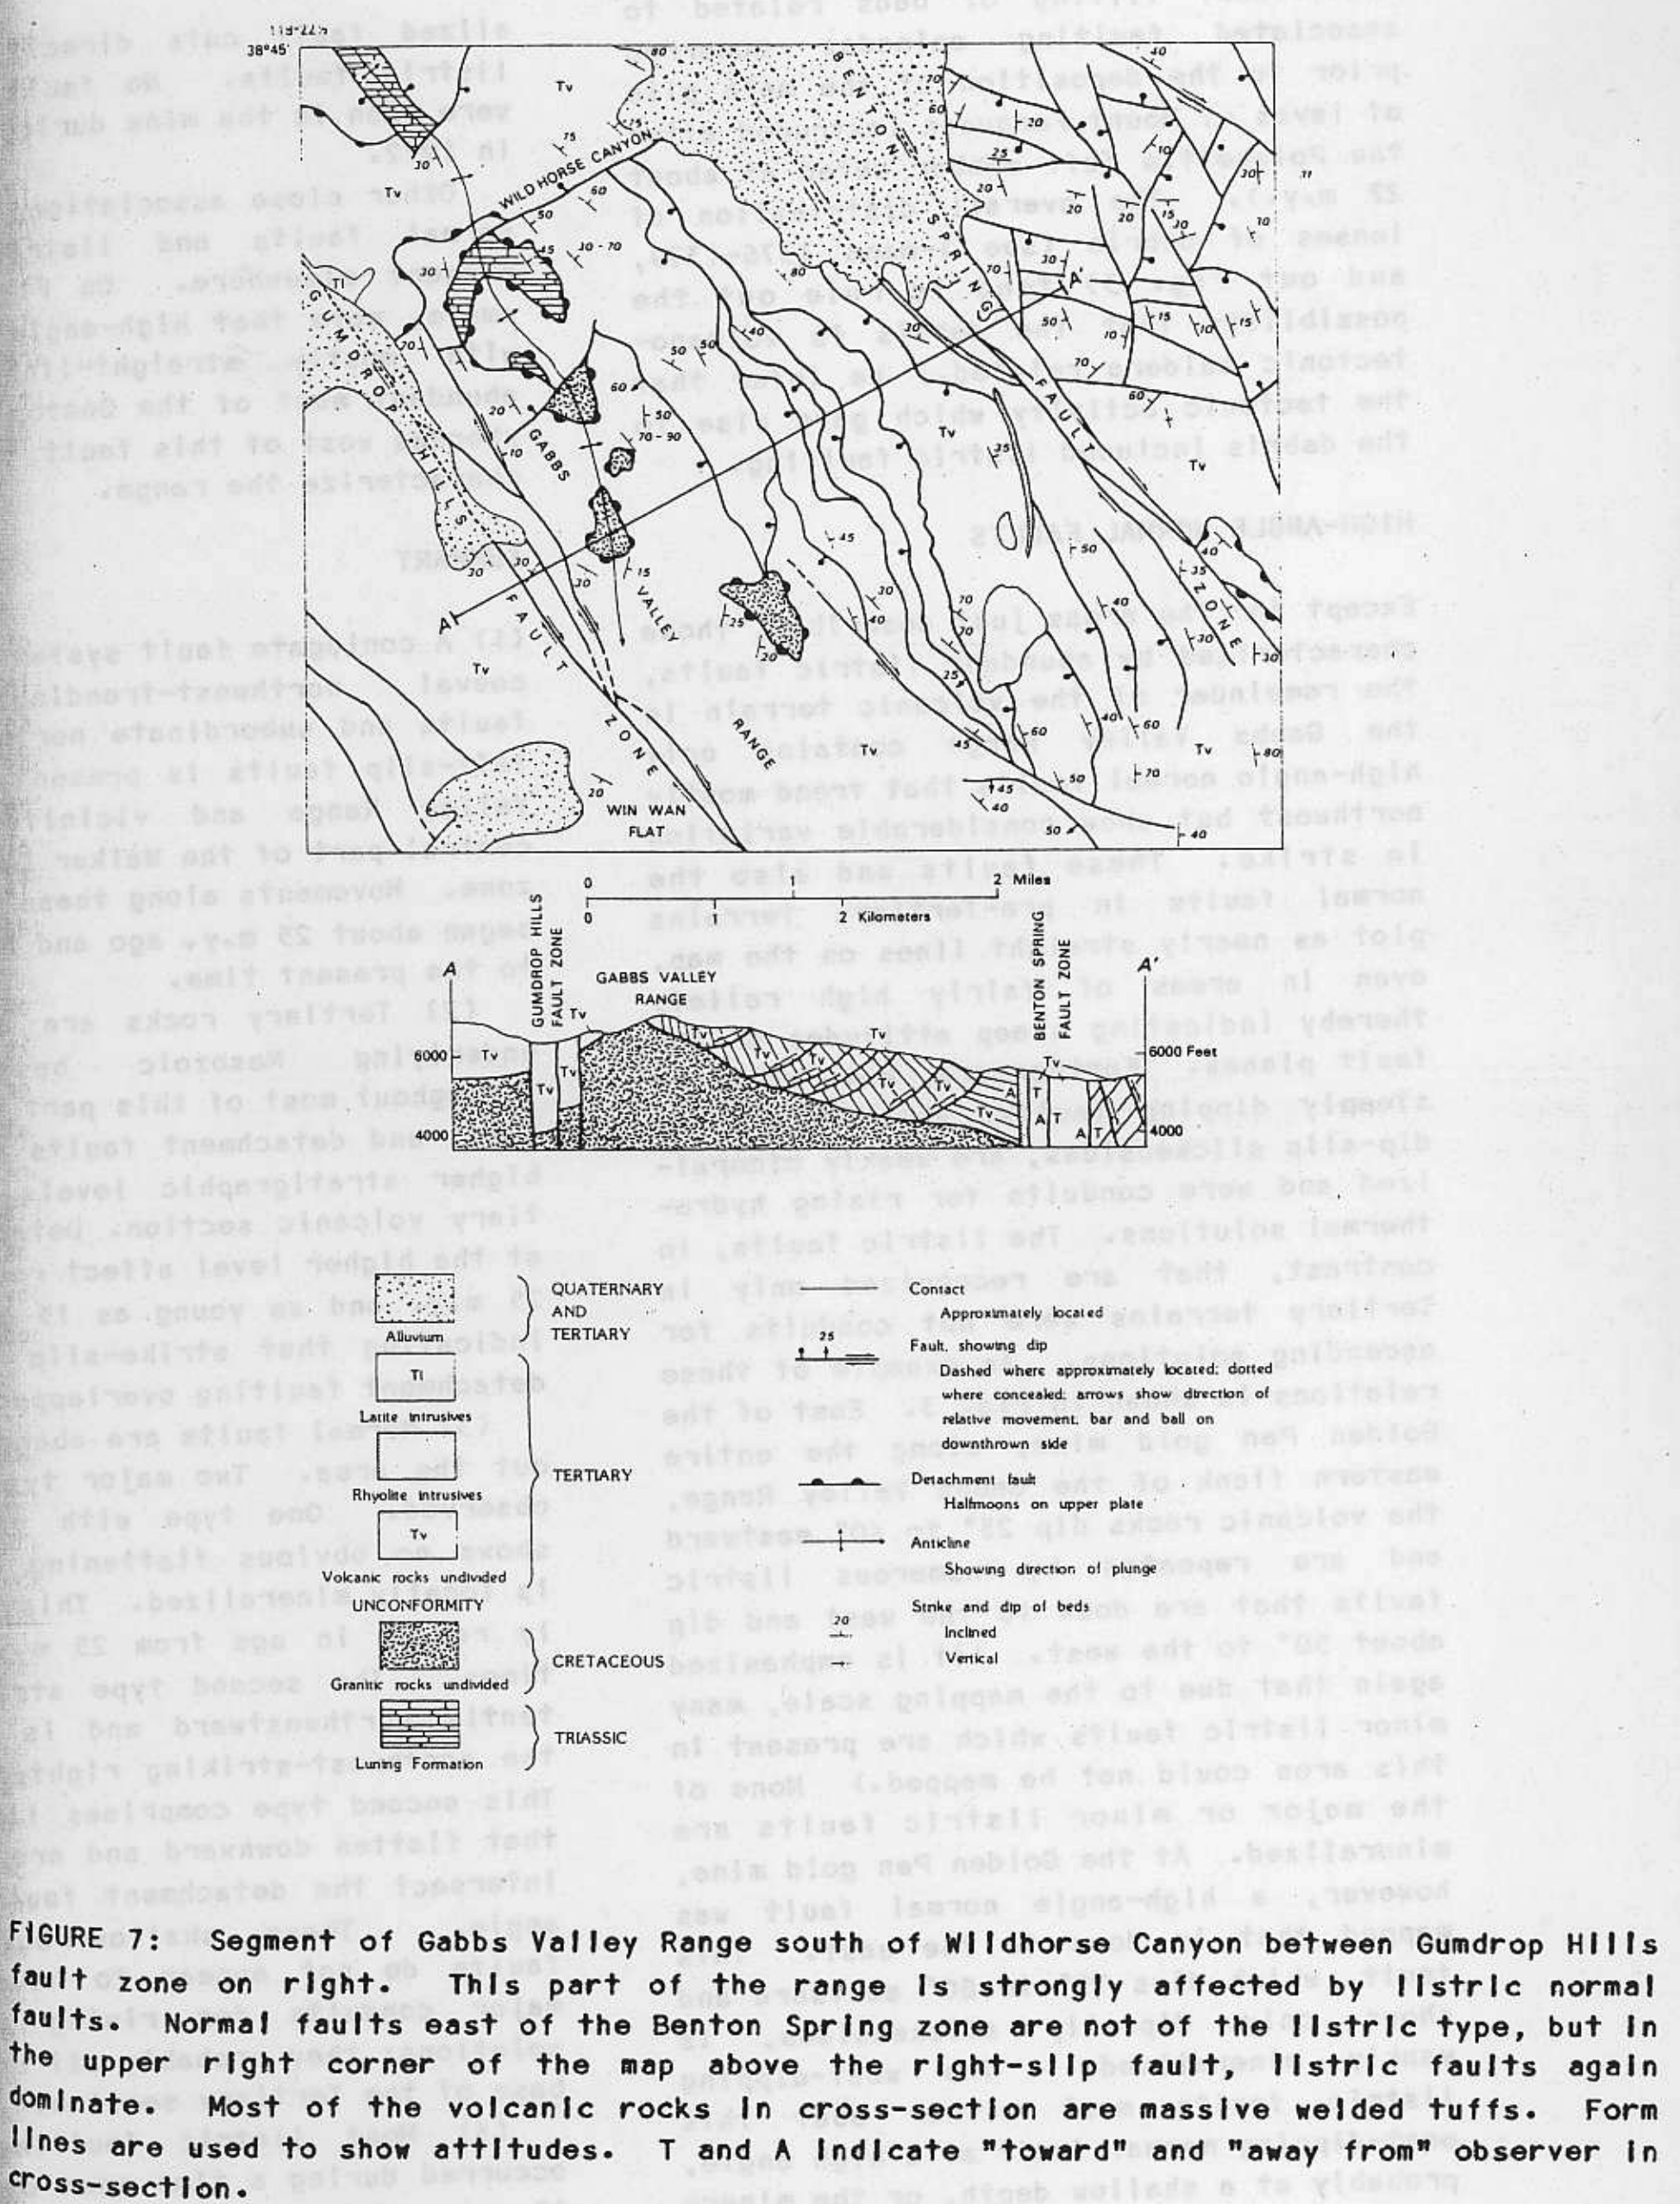
Detachment Faults
Nearly flat
Synchronous with strike-slip and listric faulting
Angular discordance between Tertiary Tuff and Mesozoic Batholith- best evidence of decollements
Tuff has steep dip (60º) within 3-4 meters of Mesozoic Batholith
Small amount of displacement (<1 km)
Best documented decollements are in Gillis Range

Slide 8
Listric Faults
Repetitious & conspicuous
Westwardly dipped 40-60º, strike parallel to SSF’s
Either merge with or intersect decollement at low angle
Fault superficially resemble bedding
22-24 MA Tuff is mainly affected by LF’s, younger lava (<22-15 MA) dips less steeply than older lava and was presumably less affected
Best exposure between BSF & PSF

Slide 9
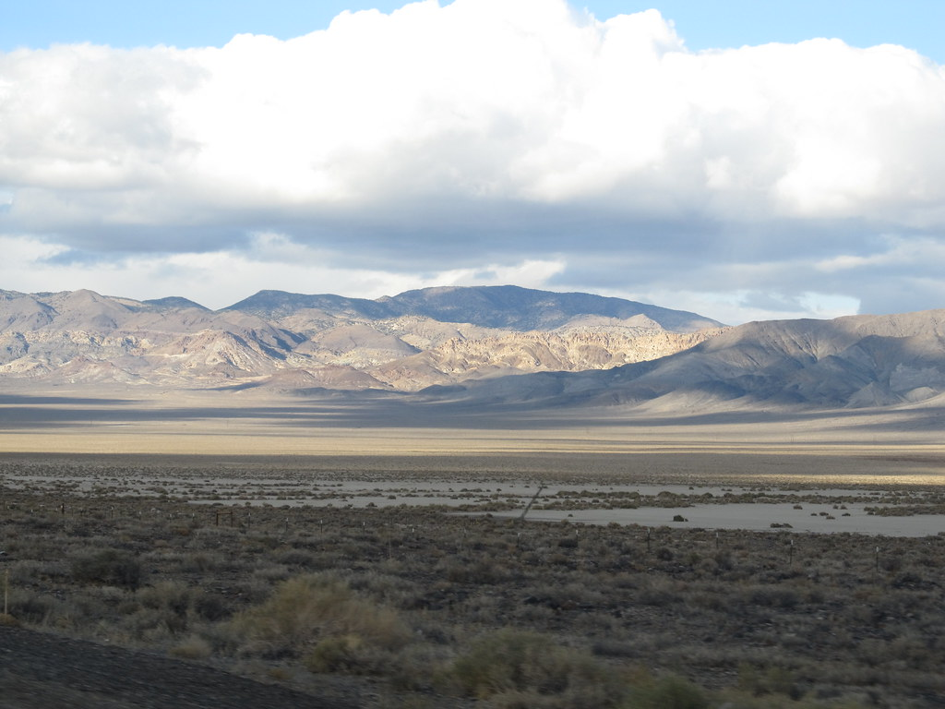
High-Angle Normal Faults
Trend NW but show variation in strike, steeply dipped (75-80º) to the east
Weakly mineralized in some places, as opposed to LF’s that show no mineralization
LF’s either abut the NF’s at high angle, or NF’s cut the LF’s (I hypothesize the latter)
Abundant east of Benton Spring Fault

Slide 10
So… how F’d up is the Gabbs Valley Range? (and by F’d up I mean Faulted Up, of course…)

Slide 11
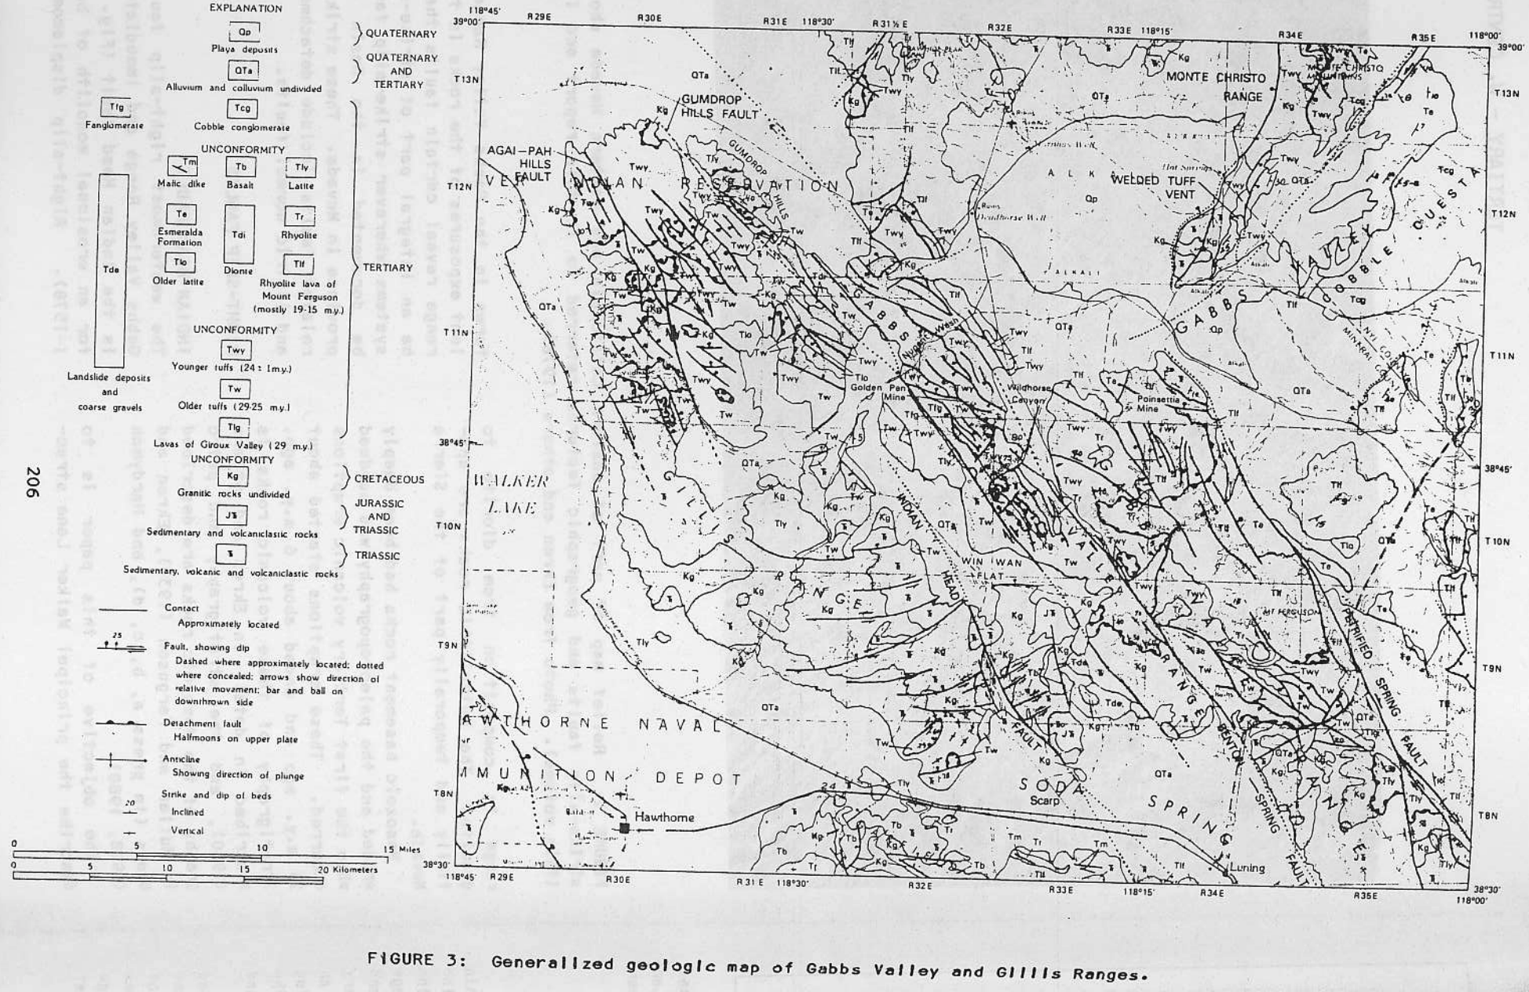

Slide 12
Summary
Conjugate NW trending right-lateral fault system with subordinate NE trending left lateral faults exists in Gabbs Valley Range in Central Walker Lane, beginning activity 25 MA and continuing today.
Detachment Faults 25-15 MA in range where Tertiary Volcanics (29-15 MA) are detached from older Mesozoic Batholith. Strike Slip and Detachment Faulting overlapped in time, but strike-slip faulting continues today & detachment faulting does not
Two types of Normal Faults: Listric Faults associated with the detachment (25-15 MA) and mineralized Normal Faults that probably cut Detachment and Listric Faults and were active from 25 MA to today.
Most listric faulting occurred over a 5-10 Million Year Period from ~24-15 MA.
The Gabbs Valley Range is an excellent microcosm of the regional tectonic processes in Walker Lane.

